Slide 1
Solution Brief Description

Slide 2

Before accessing the code
Extract the zip file containing the solver package you can download HERE, and find the bin folder in which the cbc.exe file located
Then, change the directory once you open the python codes file.
Find lines of snippet code like above inside the python codes, and adjust the directory in argument ‘executable=‘ like what I did above. In my case, I copy the bin\cbc.exe in my main C: disk.
By doing this procedures, you have done installing the cbc solver
Note: this is if you want to run the code locally, if you want to run it via Google Colab for example, please review how to install solver by visiting my notebook exercising other problem HERE

Slide 3
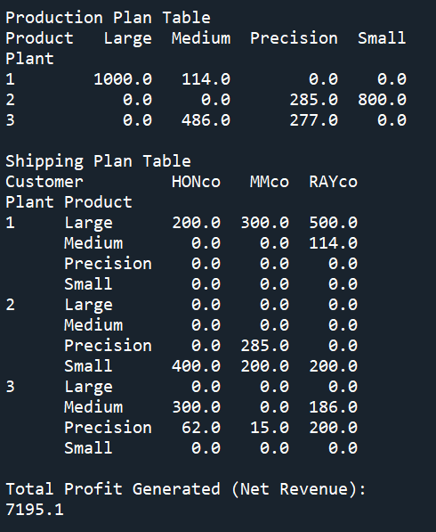
Codes 1
Upon running the codes, you will get this result on the right.
Essentially it shows the planning of production and shipping

Slide 4
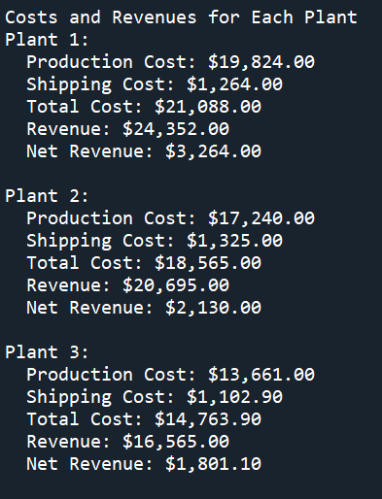
Codes 1 (con’t)
Upon running the codes, you will also get this result on the right.
Essentially it shows the revenue and cost for each plant

Slide 5
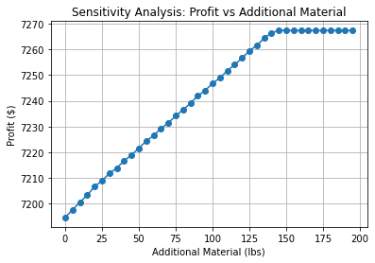
Codes 2
Upon running the codes, you will get this result on the right.
Essentially it shows the marginal increase of profit upon adding additional material resources
It means the shadow price for material constraints is around $0.66. And the allowable increase is around 140 lbs, meaning that the profit will not be increased anymore after this point since material will not be the limiting constraint.
Note: shadow price explains the maximum price which should be paid to obtain an additional unit of resource

Slide 6
Codes 2 – Alternate (Shadow Price)
Talking about what we have done in Codes 2, understand that we want to check the shadow price or maximum price per additional resource we opt to pay.
In Pyomo, there’s a way to extract this value without generating the line chart like before (so we do not need to do for loop and accumulate the result for the plotting)
Please observed the codes and notice it’s rather blatant differences compared to codes 2.
Upon running, you will get result on the right.
NOTE: the result is lower than previous codes 2 which imply nonoptimality. This is due to the solver used is different. Previously was CBC, and for this trial we use IPOPT.

Slide 7
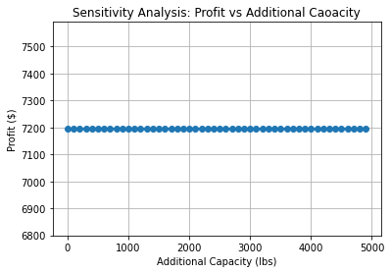
Codes 3
Upon running the codes, you will also get this result on the right.
Essentially it shows the marginal increase of profit upon adding additional inspection capacity resources
It means the shadow price for inspection capacity constraints is 0. Adding more capacity will give no effect
Note: shadow price explains the maximum price which should be paid to obtain an additional unit of resource

Slide 8
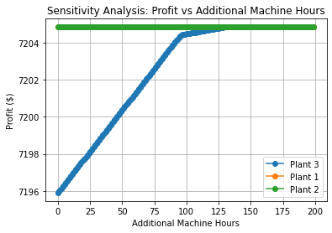
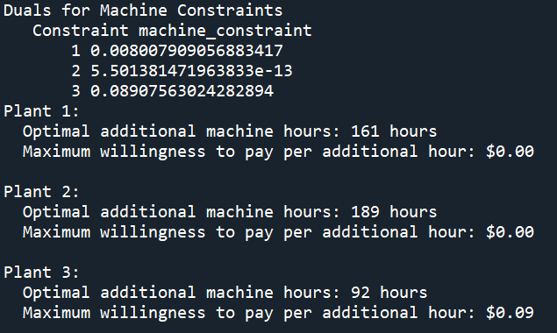
Codes 4
Upon running the codes, you will also get this result on the right.
Essentially it shows the marginal increase of profit upon adding machine hours for each plant
It means the shadow price for plant 3 which giving the best possible increase of profit, is 0.09 and after adding 92 hours, the profit is not increasing anymore (or increasing but now too insignificantly). 92 hours signifies the allowable increase.

Slide 9
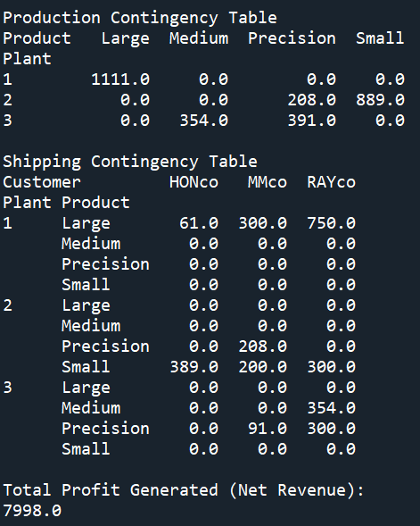
Codes 5
Upon running the codes, you will get this result on the right.
Essentially it shows the planning of production and shipping after adding 50% demand for RAYco
Note that total profit is increasing compared to without demand, this indicate that the model is opting to fulfill RAYco demand due to its sales price

Slide 10
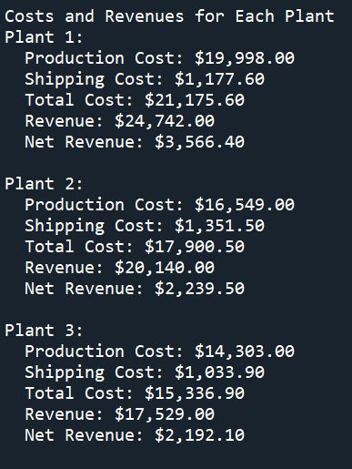
Codes 5 (con’t)
Upon running the codes, you will also get this result on the right.
Essentially it shows the revenue and cost for each plant after adding 50% demand for RAYco

